Slide 1
Live data in the Service Worker

Slide 2
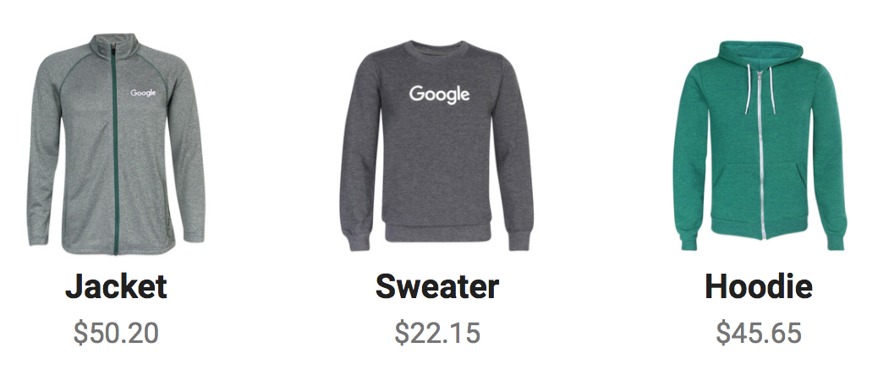
How would you store this data?
Notes:
This is an example of an ecommerce site with multiple "kinds" of data. In this case there are images and numeric data, as well as HTML and CSS resources (and probably JS). The question here: which data goes where?
Image from Polymer project

Slide 3
General guidelines
Cache
Static, URL addressable assets
IndexedDB
Dynamic data
{
"clothing": {
"name": "jacket",
"price": "50.20",
"quantity": "200"
}
}
.html
.css
.js
.jpg
Notes:
The general rule is that:
Resources addressed through a URL will be stored in the Cache
Dynamic resources will be stored in an IndexedDB database
For example:
App Shell resources, images, and stylesheets should be stored in the cache.
Dynamic JSON data should be stored in indexedDB.

Slide 4
Store data locally
App
Network
IndexedDB
Cache API
Notes:
Start by storing data locally.
Here we are using the Cache API and IDB API

Slide 5
Put JSON data in IDB
App
Network
IndexedDB
Cache API
Notes:
Storing data in IDB

Slide 6
IndexedDB
# | Key (key-path 'id') | Value
0 | 123 | {id: 123, name: 'jacket', price: 50.20, quantity: 20}
1 | 987 | {id: 987, name: 'sweater', price: 22.15, quantity: 10}
2 | 456 | {id: 456, name: 'hoodie', price: 45.65, quantity: 15}
Notes:
What does IDB look like?
It does not look like a conventional SQL table!
IDB data is stored as key-value pairs in object stores. A single IDB database can have multiple object stores. This could be a 'clothing' object store inside a 'products' database.

Slide 7
Store data on activate
self.addEventListener('activate', function(event) { event.waitUntil( createDB() ); });
Notes:
The activate event is a good place to create an IDB database.
(1. you don't want to create it more often than needed, for efficiency, and
2. Doing during installation could cause issue with the existing sw)
Note:
event.waitUntil ensures that the service worker does not terminate preemptively during async actions.

Slide 8
Creating an IDB database
function createDB() { productsDB = idb.open('products', 1, function(upgradeDB) { var store = upgradeDB.createObjectStore('clothing', { keyPath: 'id' }); store.put({id: 123, name: 'jacket', price: 50.20, quantity: 20}); }); }
Notes:
Here we create an IDB 'products' database. It is version 1.
Inside the 'products' database, we create a 'clothing' object store. This will hold all of the clothing objects.
The 'clothing' object store has a keyPath of 'id'. This means that the objects in this store will be organized and accessed by the 'id' property of the 'clothing' objects.
Note: we are using Jake Archibald's IndexedDB Promised library to enable promise syntax with IDB.

Slide 9
Put resources in the Cache
App
Network
IndexedDB
Cache API
Notes:
Storing resources with the Cache API

Slide 10
Cache assets on install
self.addEventListener('install', function(event) { event.waitUntil( cacheAssets() ); });
Notes:
A common pattern is to cache assets on service worker installation.
Note:
event.waitUntil ensures that the service worker does not terminate preemptively during async actions.

Slide 11
Caching assets
function cacheAssets() { return caches.open('cache-v1').then(function(cache) { return cache.addAll([ 'index.html', 'styles/main.css', 'js/offline.js', 'img/jacket.jpg' ]); }); }
Notes:
In this example we create a 'cache-v1' cache and store static assets (HTML, CSS, JS, images) with the Cache API.

Slide 12
Get data out of IDB
App
Network
IndexedDB
Cache API
Notes:
Now we can get data from IDB instead of the network

Slide 13
Get clothing data for UI
function readDB() { productsDB.then(function(db) { var tx = db.transaction(['clothing'], 'readonly'); var store = tx.objectStore('clothing'); return store.getAll(); }).then(function(items) {/* Use clothing data */}); }
Notes:
Here we open the 'products' database, and create a new **transaction on the 'clothing' store, of 'readonly' type (we don't need to write data). We then access the store, and retrieve all of the items. These items can then be used to update the UI or whatever is needed.
**A transaction is wrapper around an operation, or group of operations, to ensure database integrity. If one of the actions within a transaction fail, none of them are applied and the database returns to the state it was in before the transaction began. All read or write operations in IndexedDB must be part of a transaction***. This allows for atomic read-modify-write operations without worrying about other threads acting on the database at the same time.
Note: we are using Jake Archibald's IndexedDB Promised library to enable promise syntax with IDB.

Slide 14
Get resources from the Cache
App
Network
IndexedDB
Cache API
Notes:
Now we can also get resources like HTML, CSS, JS, and images from the cache instead of the network

Slide 15
Fetch from the Cache
self.addEventListener('fetch', function(event) { event.respondWith( caches.match(event.request).then(function(response) { // Check cache but fallback to network return response || fetch(event.request); }) ); });
Notes:
Here we add a fetch listener to the service worker. When a fetch is made for a resource, we try to find the resource in the cache and return it. However, if it isn't in the cache we still want to go to the network for it.

Slide 16
Resources
Resources
Offline Storage for PWA’s
Detailed support testing
Support for IndexedDB
IndexedDB Promised
Pokedex.org
Cache API support

Slide 17
Extra credit

Slide 18
Offline user actions
App
Network
IndexedDB
Cache API
Notes:
What can we do about actions that a user takes when offline? For example purchasing a product.
We can record them in IDB

Slide 19
Record failed requests
fetch('purchaseUrl', {method: 'post', body: 'item=123'}) .then(function(response) { // Normal transaction }) .catch(function(error) { // Save item/action in IDB });
Notes:
It's possible to record actions a user takes while offline.
In this example, a user is trying to make an item purchase via HTTP request, which will fail if offline. If the purchase fails, the catch block will execute. This is where we could store the item or user action in IDB.

Slide 20
When connectivity returns?
App
Network
IndexedDB
Cache API
Notes:
How do we use this once connectivity returns?

Slide 21
Re-send recorded requests
// Get saved items from IDB, then fetch('purchaseUrl', {
method: 'post',
body: item
}) .then(function(response) { // Success. Delete IDB item/action });
Notes:
Once connectivity returns, the recorded items / actions in IDB can be retrieved and sent. If the requests are successful, the corresponding item / action can be deleted from the IDB records.

